Slide 1

Utilizing Neural Networks To Categorize Songs.
Max Bermont

Slide 2



Agenda
Define the Problem
The Data
The Model
The Results

Slide 3
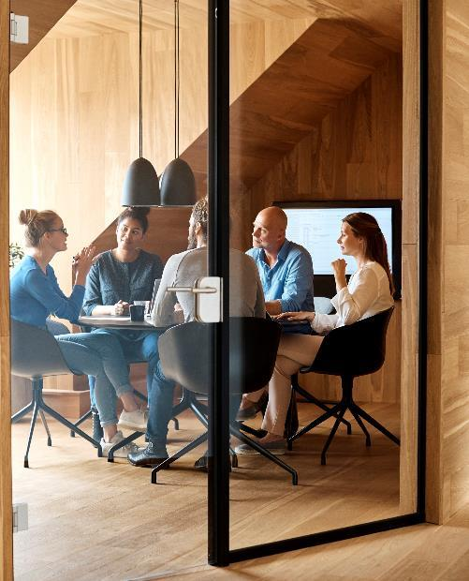



Introduction
Spotify is one of the largest audio streaming services in the world. They have 345 million active users and over 70 million songs. Th

Slide 4

Defining the Problem
I have been tasked by Spotify to create a model that will assign genres to songs that are being added to the platform.

Slide 5

The Data
From Kaggle
Target Values
Target Distribution

Slide 6
Charts

Slide 7
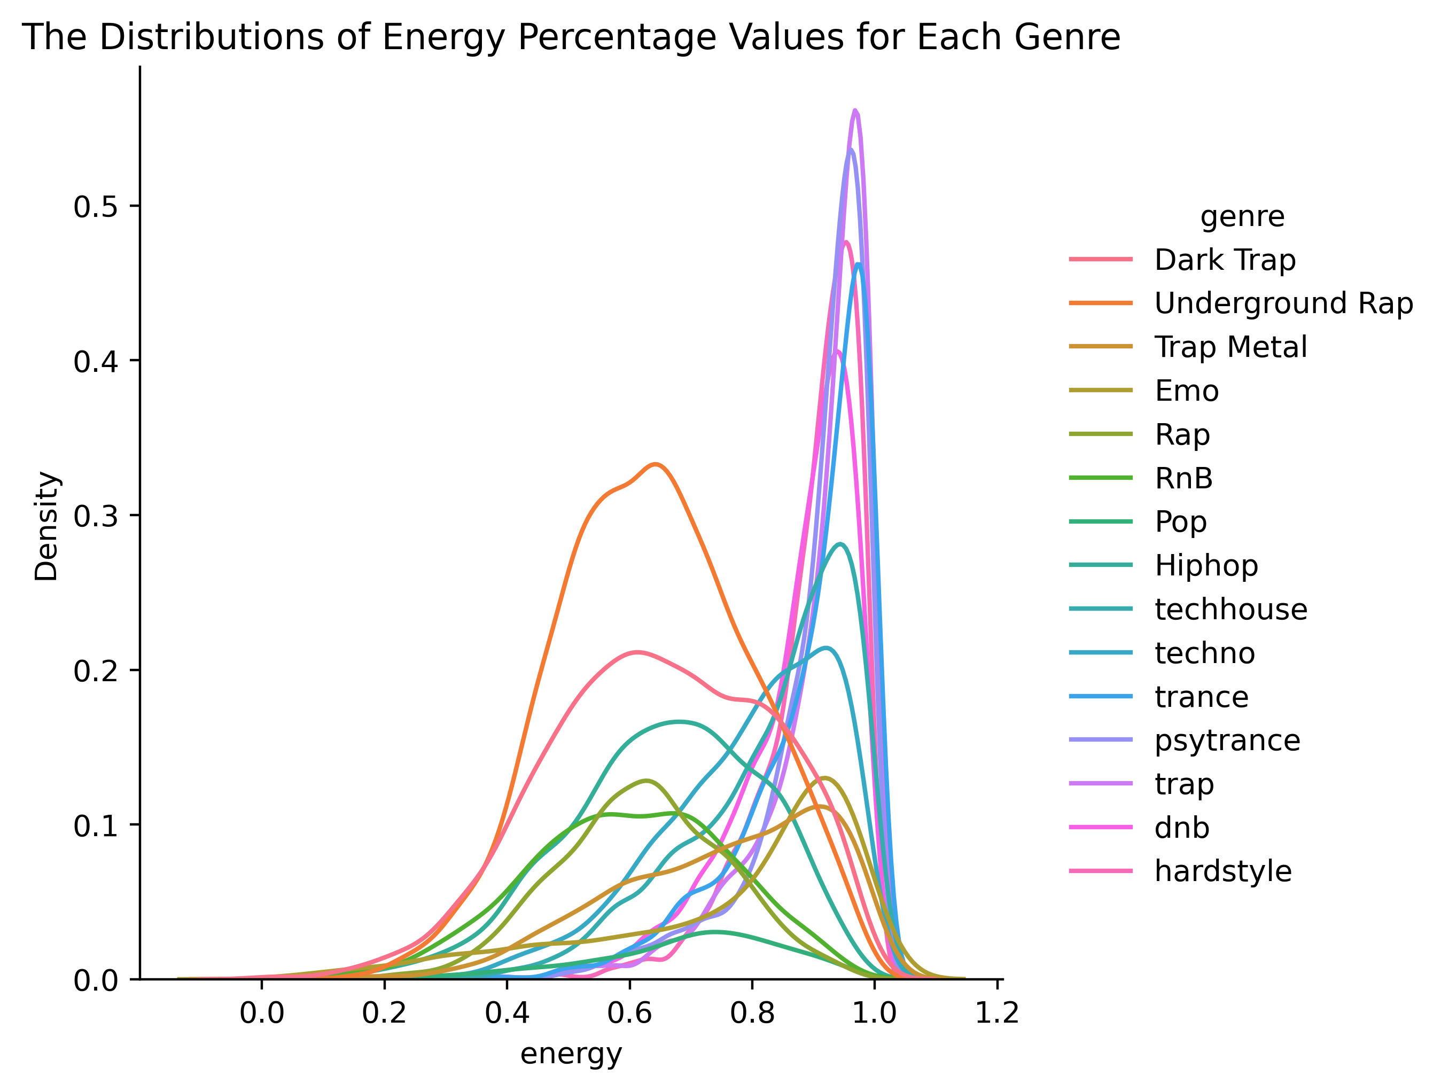
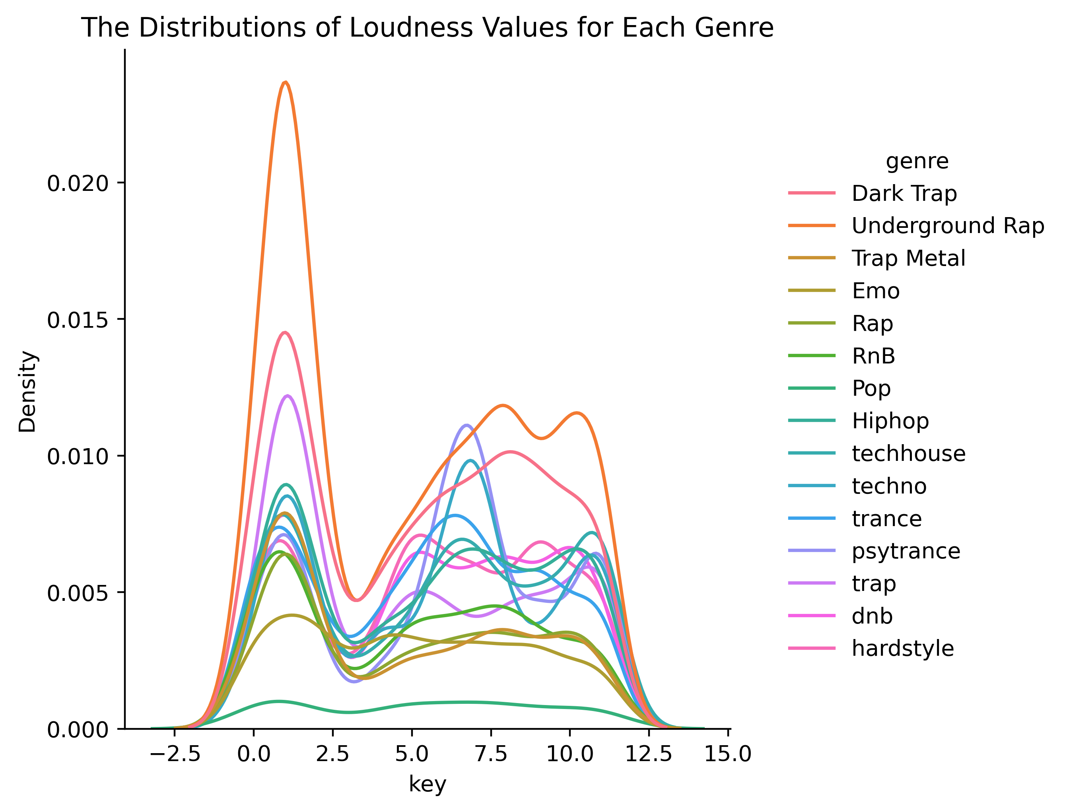
Charts

Slide 8

The way to get started is to quit talking and begin doing.
Walt Disney

Slide 10
Timeline
Title
To start a presentation, go to the Slide Show tab, and select From Beginning.
Title
To display Presenter view, in Slide Show view, on the control bar at the bottom left select the three dots, and then Show Presenter View.
Title
During your presentation, the speaker notes are visible on your monitor, but aren't visible to the audience.
Title
Title
If you don’t see the Notes pane or it is completely minimized, click Notes on the task bar across the bottom of the PowerPoint window.
The Notes pane is a box that appears below each slide. Tap it to add notes.

Slide 11
Content
Subtitle
Subtitle
Add text, images, art, and videos.
Add transitions, animations, and motion.
Save to OneDrive, to get to your presentations from your computer, tablet, or phone.
Open the Design Ideas pane for instant slide makeovers.
When we have design ideas, we’ll show them to you right there.

Slide 12
Content 2
Subtitle
subtitle
subtitle
Add text, images, art, and videos.
Add transitions, animations, and motion.
Save to OneDrive, to get to your presentations from your computer, tablet, or phone.
Open the Design Ideas pane for instant slide makeovers.
When we have design ideas, we’ll show them to you right there.
Add text, images, art, and videos.
Add transitions, animations, and motion.
Save to OneDrive, to get to your presentations from your computer, tablet, or phone.
Open the Design Ideas pane for instant slide makeovers.
When we have design ideas, we’ll show them to you right there.
Add text, images, art, and videos.
Add transitions, animations, and motion.
Save to OneDrive, to get to your presentations from your computer, tablet, or phone.
Open the Design Ideas pane for instant slide makeovers.
When we have design ideas, we’ll show them to you right there.

Slide 13

Summary
I have a designed a model

Slide 14


Thank You
Max Bermont
mjbermont@gmail.com
https://github.com/mbermont/

